Slide 1




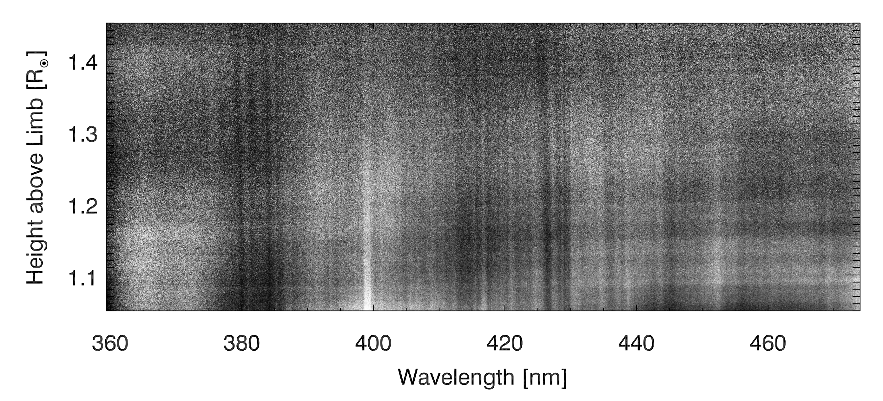
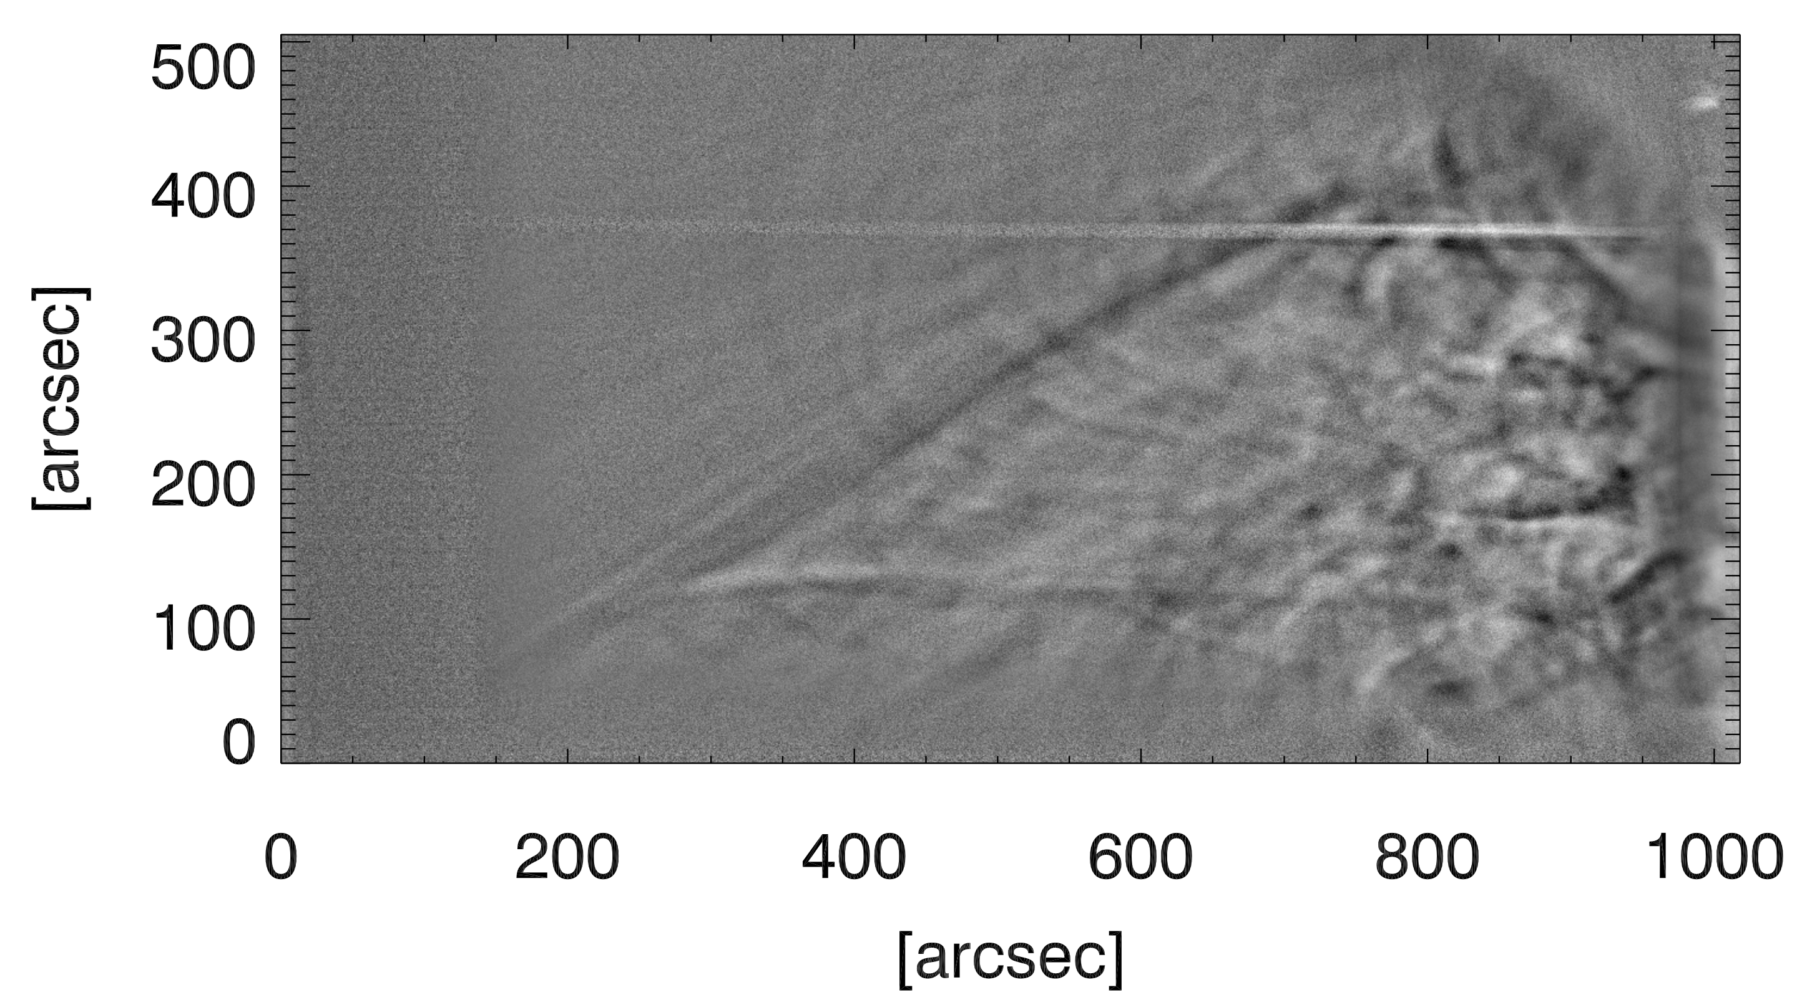
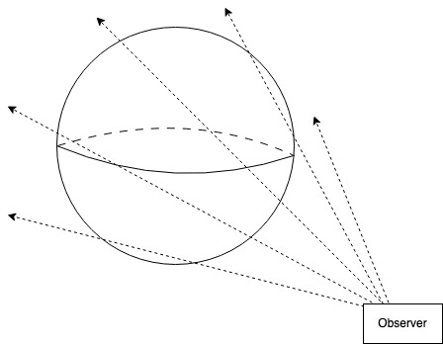
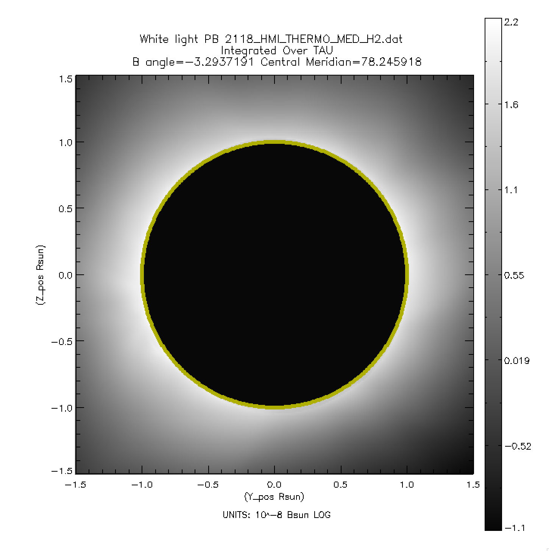
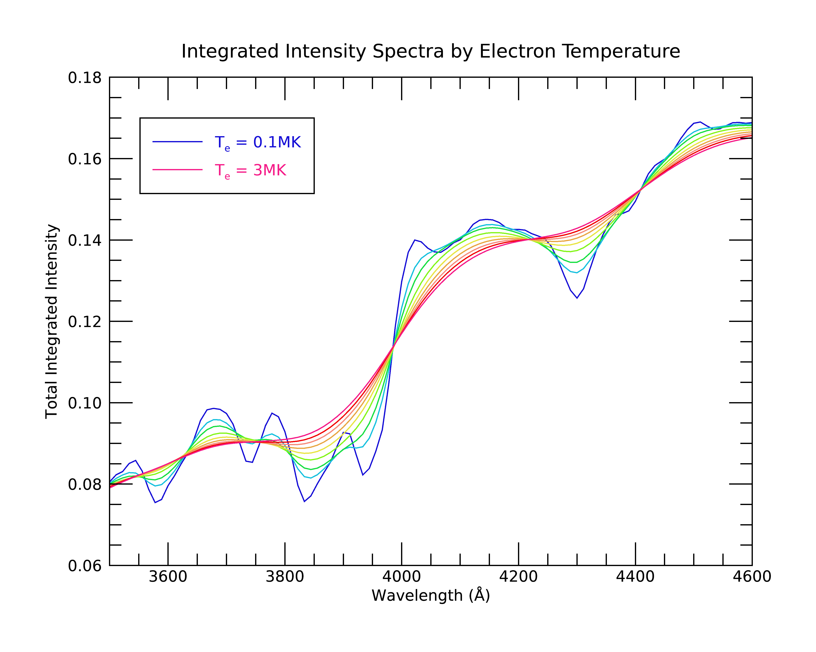
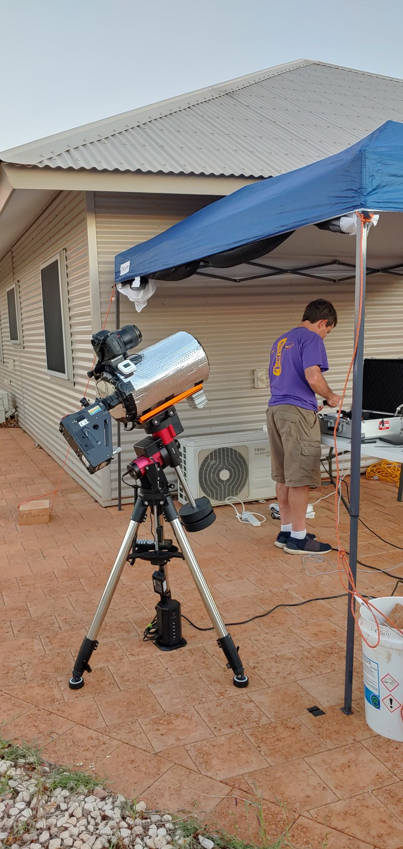
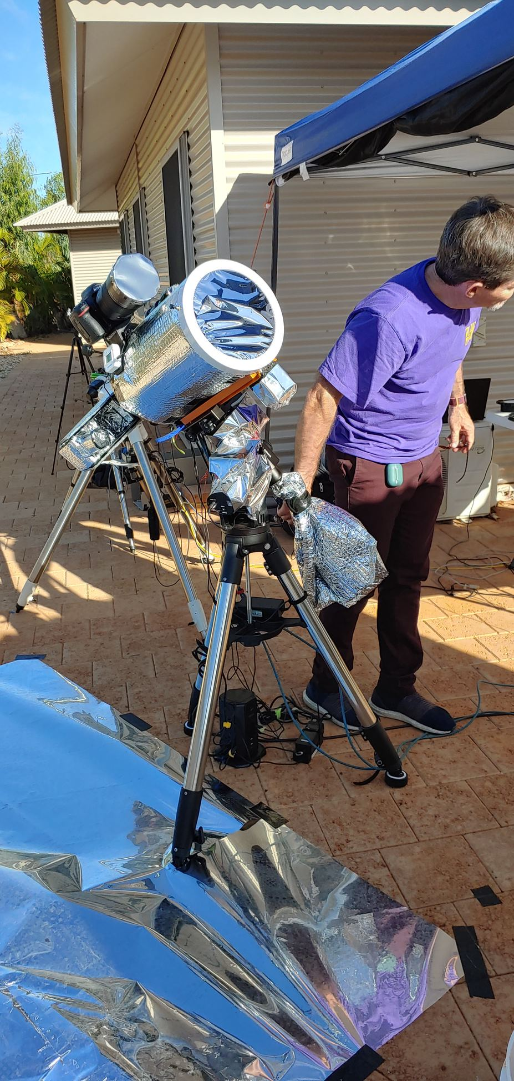
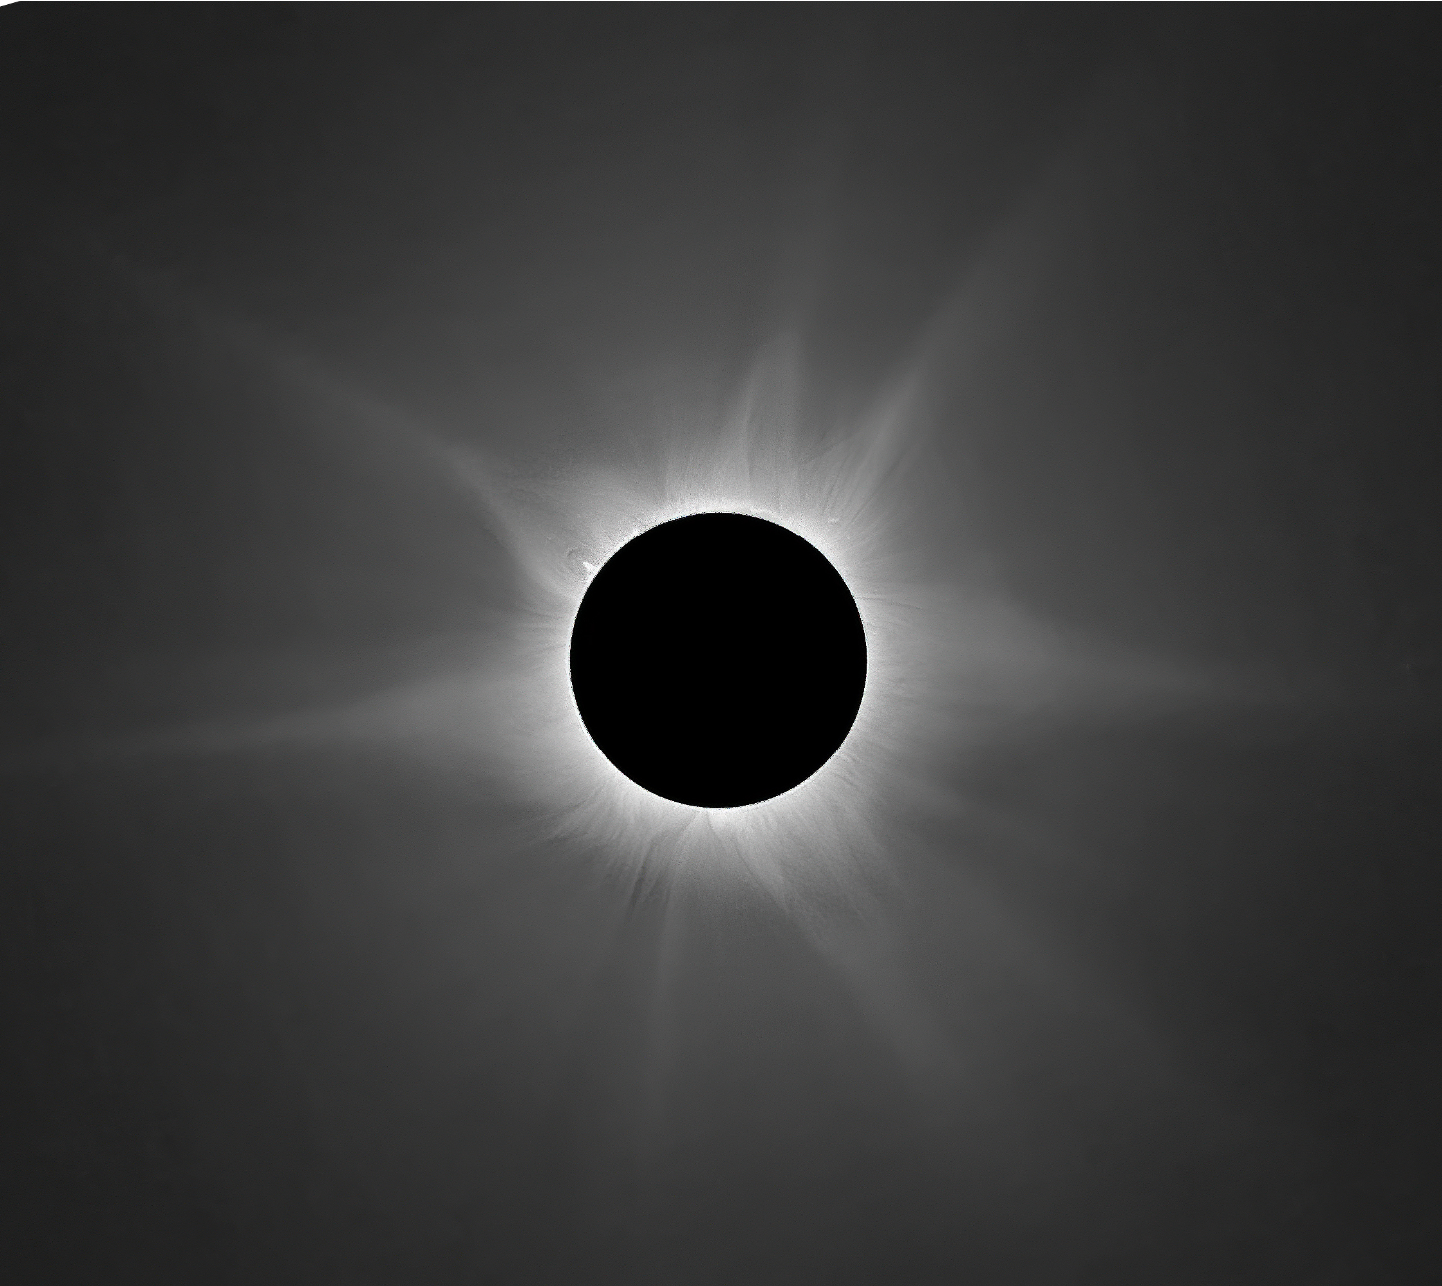
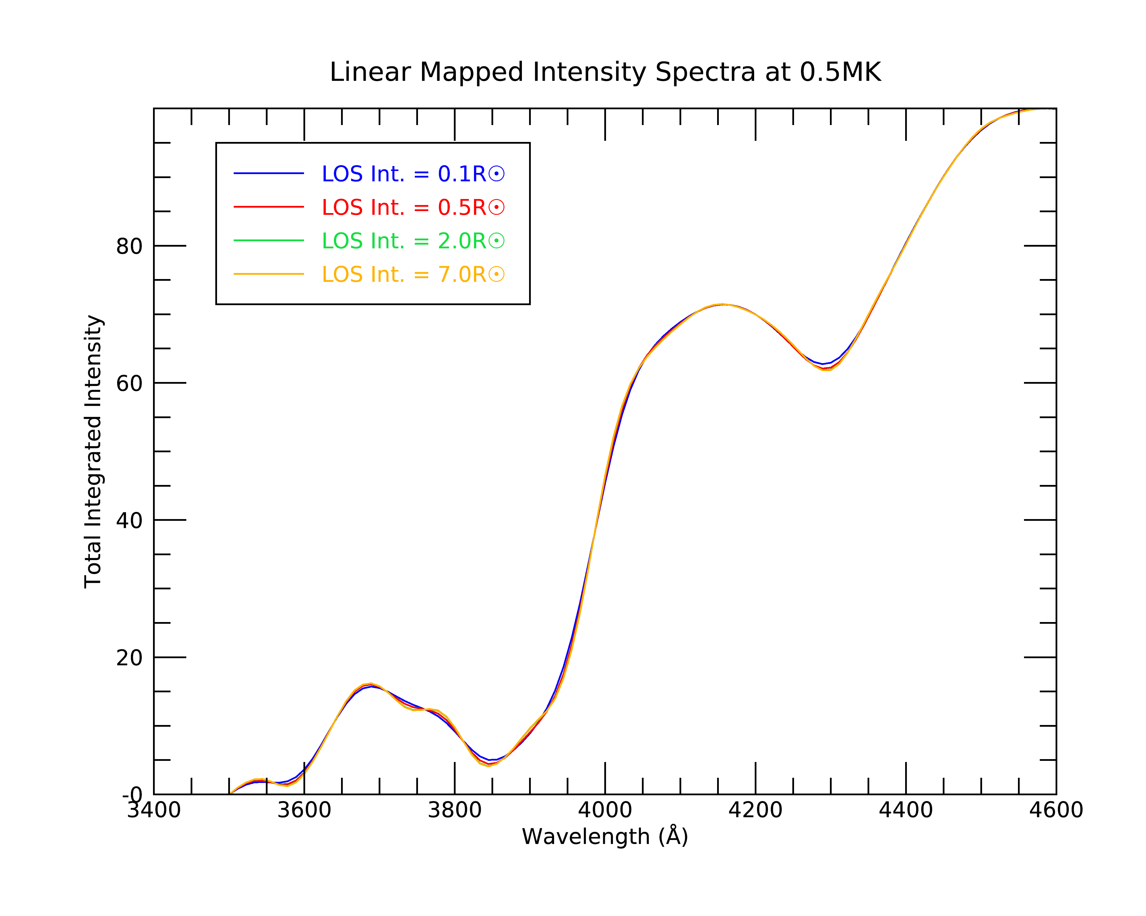
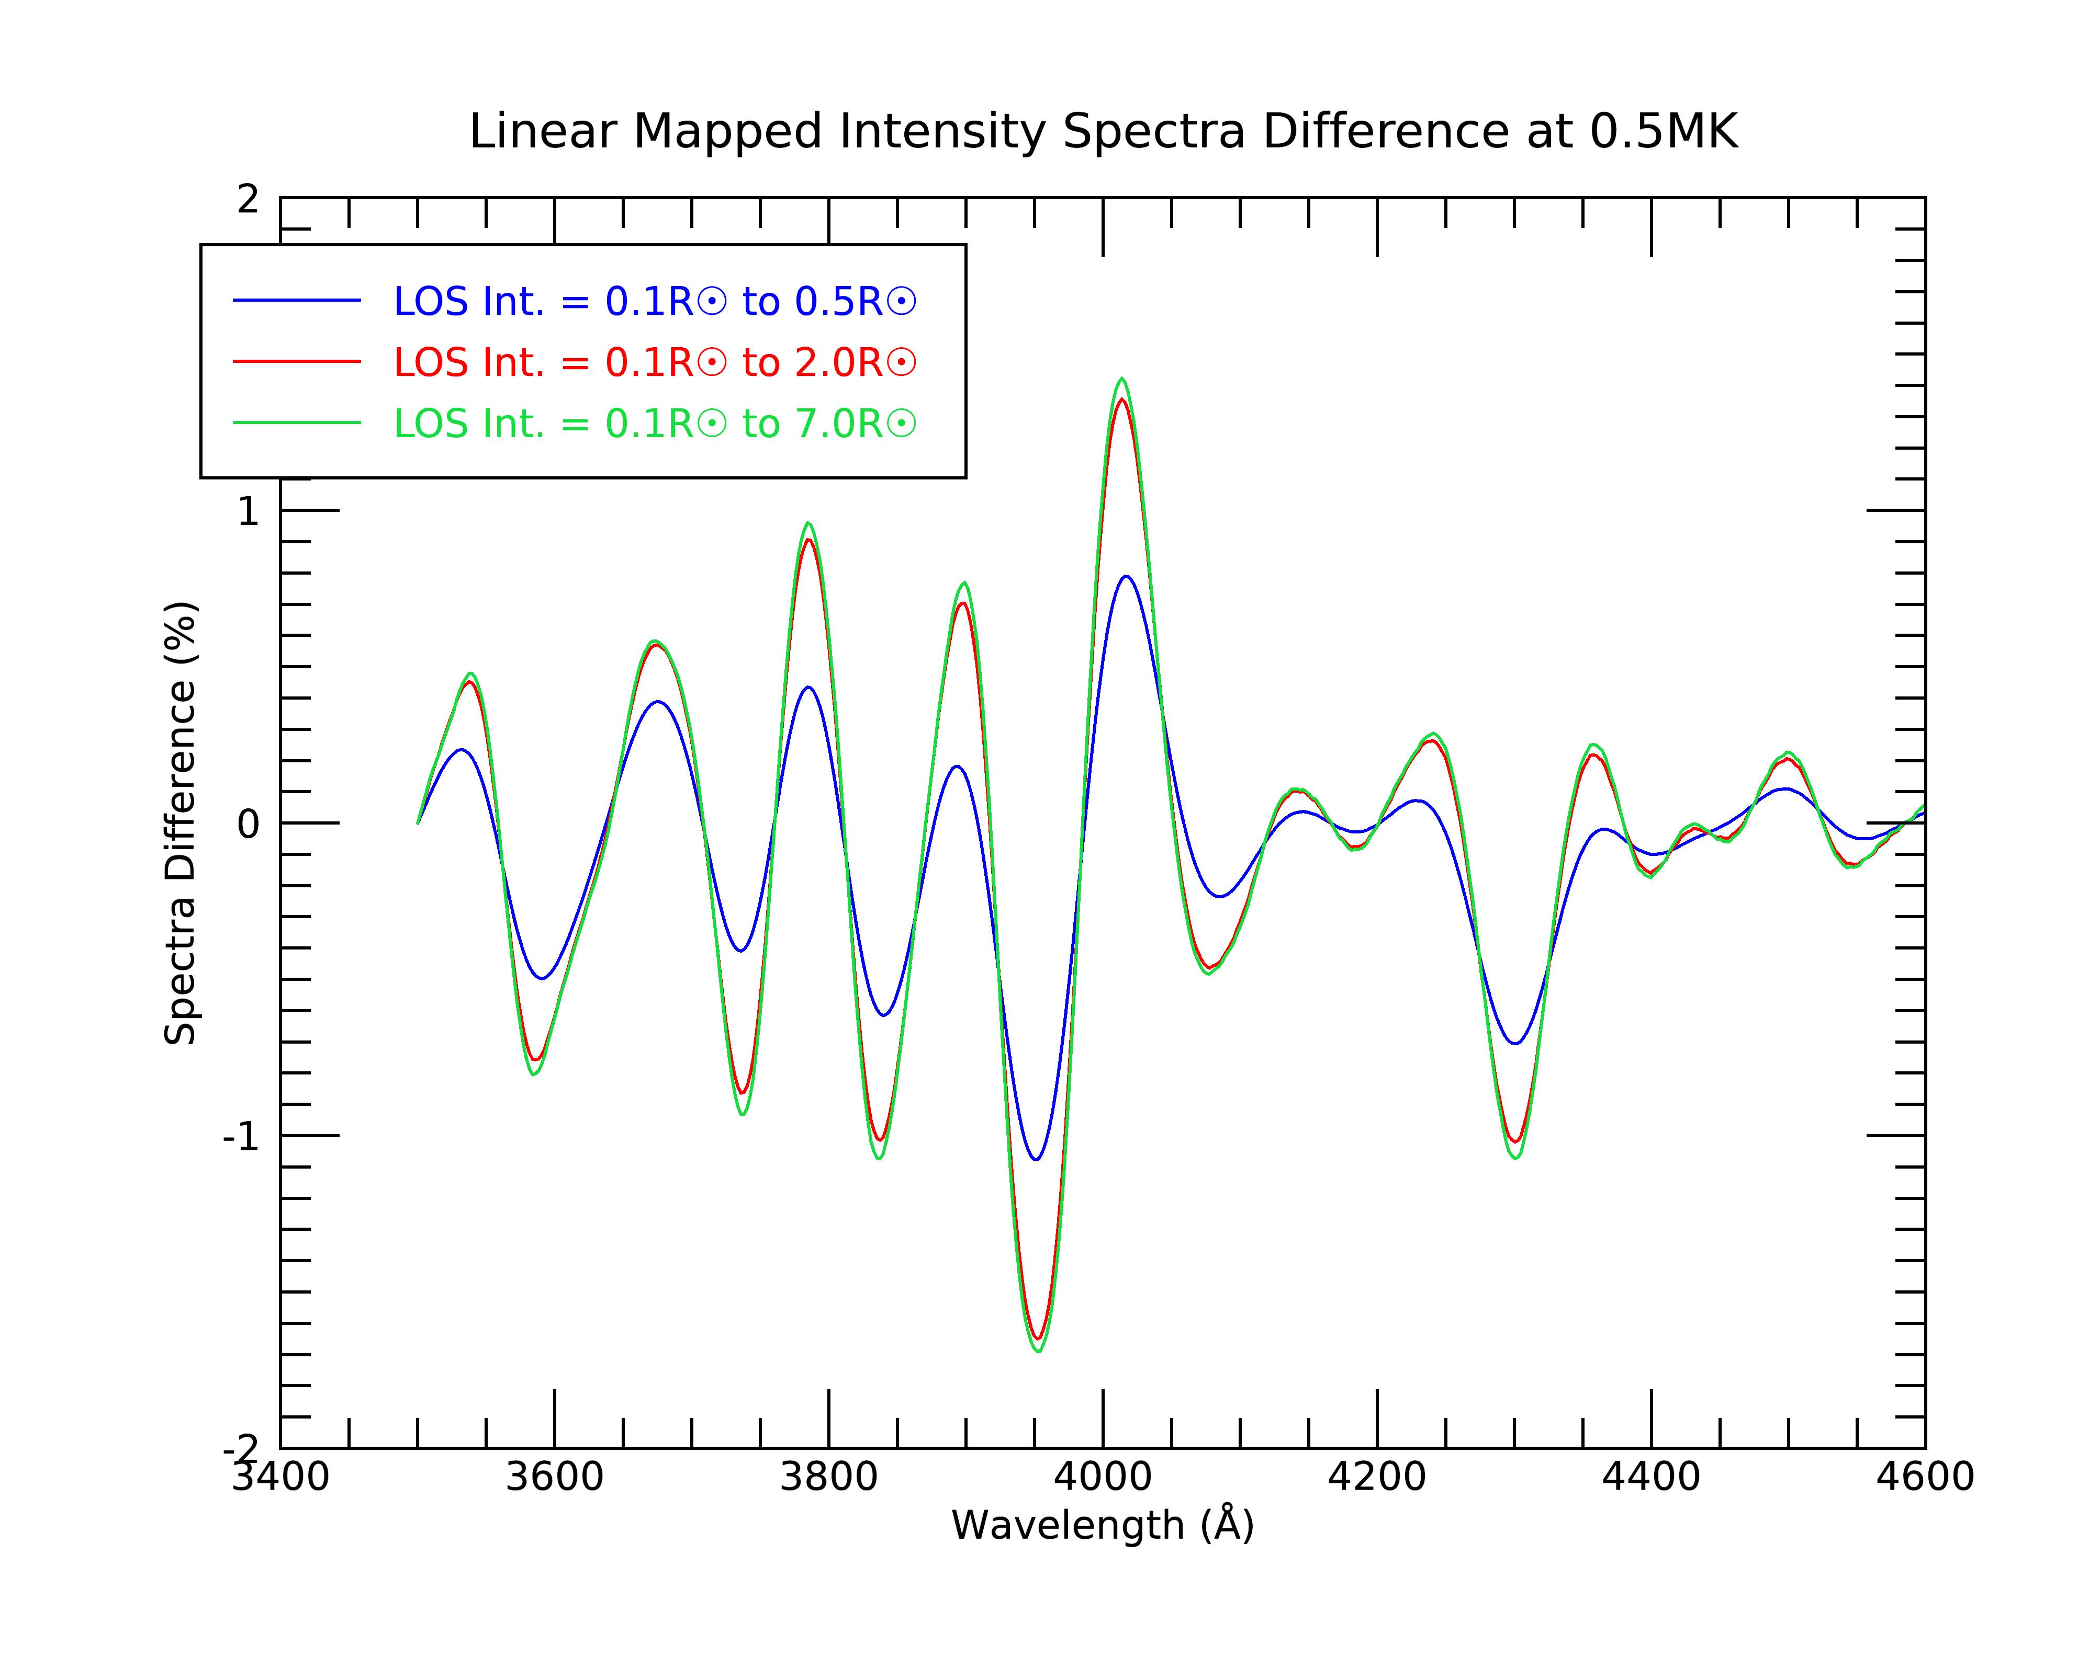
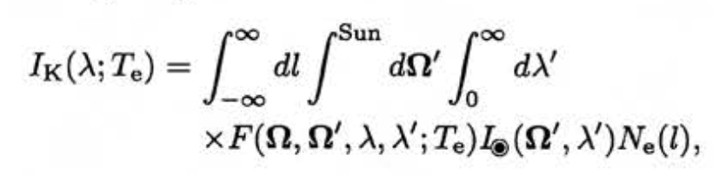
K-Coronal Temperatures Eclipse Experiments at
the 2023 and 2024 Eclipses
Sarah Bruce^{1,2}, Kevin Reardon^{1,2} ¹Department of Astrophysical and Planetary Sciences, University of Colorado Boulder, ²National Solar Observatory
Introduction
Eclipse Data
Future Work
During the 52-second total solar eclipse of 20 April, 2023 in Exmouth, Australia, we carried an experiment aiming at investigating the low solar corona. We used a low dispersion (0.28 Å/pixel) slit spectrograph to obtain spectra covering the interval from 3600-4700 Å between 1-1.5 R☉). The scattering of the photospheric emission by the high-temperature, high-velocity coronal electrons smears out any Fraunhoffer lines but leaves broad spectral signatures that can be used to infer the magnitude of the broadening and hence the coronal electron temperature (Cram, 1976). Such measurements have been carried out a few times in the past (e.g. Ichimoto, et al., 1996; Reginald, 2009) and are the basis of the upcoming CODEX mission.
Sample coronal spectrum from 2024 eclipse.
Slit-jaw image from 2024 eclipse.
Experiment
FORWARD Modeling
Line of sight integration diagram – each spatial point integrates over ~150 points along the LOS.
After completing the data reduction on the sets of eclipse data, we will compare the observed spectra to the synthesized spectra output from FORWARD. We will use the PSI MAS model corona for the day of the eclipse as the input for the FORWARD calculations. Our slit-jaw imager will be used to perform co-alignment with SDO/AIA and determine which spatial points in the FORWARD calculation to use as a comparison. Measured reference spectral irradiance profile will be used as the photospheric spectra for the scattering calculation.
This new function will also be useful for interpreting to data from the CODEX mission. After its launch in 2024, CODEX’s coronagraph will take images of the corona in several wavelengths. Using FORWARD and updated models, we can generate synthetic images at the same filter bands as CODEX, at greater radial distances, for direct comparison with the observations.
For this experiment, we used a Shelyak Lhires III grating spectrograph attached to an 8” Celestron telescope. The setup was equipped with solar filters as well as reflective wrapping to keep the instrument at a more stable temperature. A reflective tarp was placed on the ground to minimize image quality degradation due to local heating of the ground.
K-Coronal Temperatures
White light coronagraph simulation using PSI-MAS model in FORWARD.
FORWARD is an IDL software package that uses realistic 3-D models of the corona volume to simulate a range of coronal observables. Currently, FORWARD uses electron densities to output a wavelength-independent K-corona brightness. We are implementing the full calculation of the K-corona scattering spectrum, following the method of Cram (1976), which will compute the LOS-integrated spectrum based on the temperature and velocity components of the 3-D model.
References
Using solar irradiance spectra, we calculate coronal spectra shapes at different temperatures integrated along the line of sight (LOS). By comparing spectra obtained at the eclipses, we can infer the electron temperature at our location in the corona. We calculate LOS integration using the equation:
where l is the position along the LOS, Ω’ and Ω are the directions of incident and scattered radiation, λ’ and λ are wavelengths of incident and scattered light, T_{e} is the coronal electron temperature, F is the coefficient of Thompson scattering, and I◉ is the photospheric radiation, and N_{e} is the electron density along the LOS.
Cram, L. E. (1976), Determination of the temperature of the solar corona from the spectrum of the electron-scattering continuum, Sol. Phys., 48, 3–19.
Reginald, N. L., O. C. St.Cyr, J. M. Davila, D. M. Rabin, M. Guhathakuta, and D. M. Hassler(2009), Electron-temperature maps of the low solar corona: ISCORE results from the total solar eclipse of 29 March 2006 in Libya, Sol. Phys., 260, 347–361.
Ichimoto, K., K. Kumagai, I. Sano, T. Kobiki, T. Sakurai, and A. Munoz (1996), Measurement of the coronal electron temperature at the total solar eclipse on 1994 November 3, Pub. Astron. Soc. Jpn., 48, 545–554.
Acknowledgements
This work will reveal the extent to which the LOS integration through multiple structures might affect or bias the measured spectra. For example, we find that longer integration distances only minimally effect the spectral shape, due to the strong falloff in density.
Thanks to Sanjay Gosain and John Williams for their help during this experiment.
Sarah Bruce acknowledges the support of the University of Colorado’s George Ellery Hale Graduate Student Fellowship and funding from the NSF, WoU-MMA grant #2129401. Additional travel support was also provided by the University of Colorado Boulder Astrophysical and Planetary Sciences department.
White light corona image taken with CATE 2024 test setup by Sanjay Gosain.

